Slide 1


BANK ACCOUNT SIMULATION
Sarvadnya 1262250138
Saksham 1262253381
Soham 1262252642
Tanishka 1262253274
Pournami 1262252045
BTECH CSE-CSF DIV-13

Slide 2

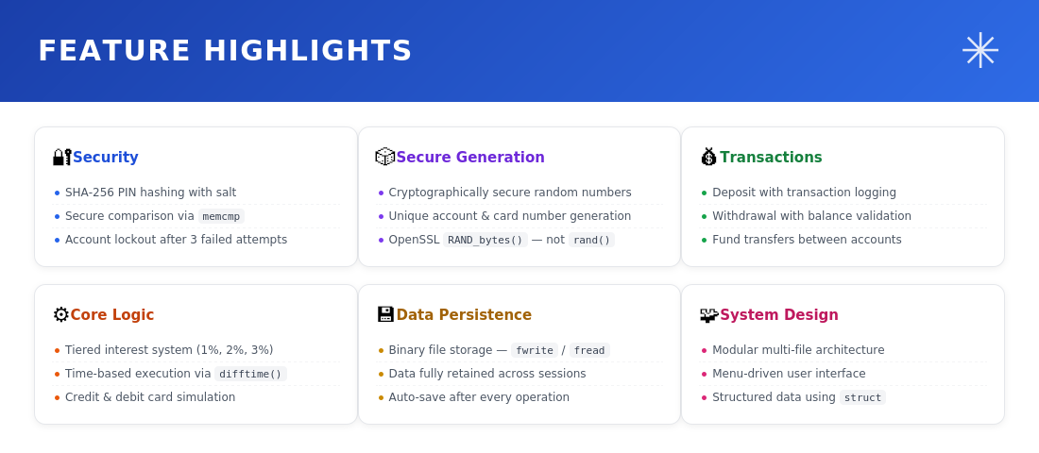
PROJECT OVERVIEW

Slide 3
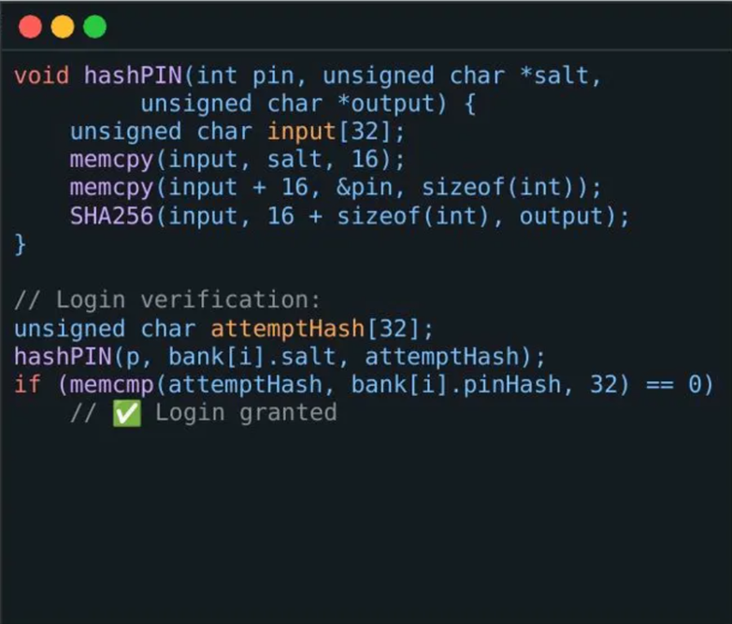
SHA-256 PIN HASHING WITH SALT
PASSWORDS ARE NEVER STORED IN PLAIN TEXT — ONLY A CRYPTOGRAPHIC HASH IS SAVED.
PIN is never stored directly — only its SHA-256 hash is written to disk.
A unique 16-byte random salt is generated per account, preventing rainbow table attacks.
On login, the entered PIN is re-hashed and compared using memcmp — constant-time safe. Used by real systems — bcrypt, Argon2, and PBKDF2 follow this same salt+hash principle.

Slide 4
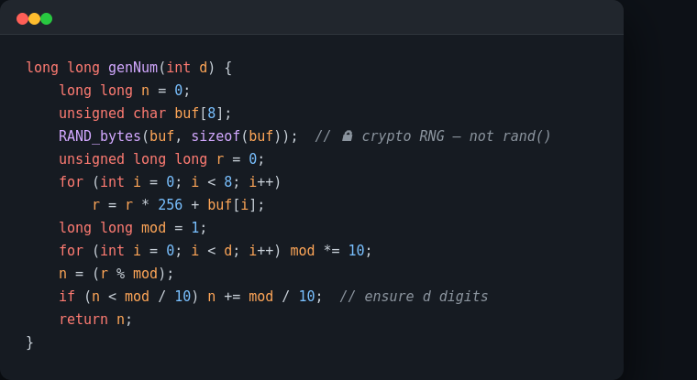
CRYPTOGRAPHICALLY SECURE RANDOM NUMBERS
ACCOUNT AND CARD NUMBERS ARE GENERATED USING OPENSSL'S RAND_BYTES — NOT PREDICTABLE RAND().
rand() is seeded and predictable. RAND_bytes() draws from the OS entropy pool.
8 bytes of raw randomness are used to construct n-digit numbers with guaranteed range.
Same RAND_bytes call generates the 16-byte salt for each account at creation. RAND_bytes is the same function used in SSL/TLS key generation.

Slide 5
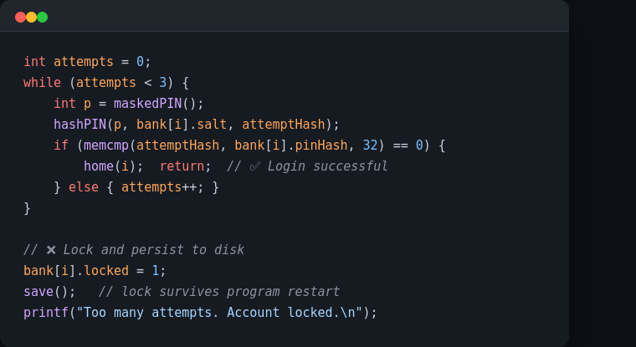
PERSISTENT ACCOUNT LOCKOUT
AFTER 3 FAILED PIN ATTEMPTS, ACCOUNTS ARE LOCKED AND SAVED TO DISK — RESTART WON'T UNLOCK THEM.
A 3-attempt counter prevents brute-force PIN guessing at runtime.
On failure, locked = 1 is set and save() is called immediately — the lock persists on disk.
On every login attempt, the lock flag is checked before the PIN prompt ever appears. Real banks lock cards after 3 wrong PIN attempts — this replicates that exact behaviour.

Slide 6
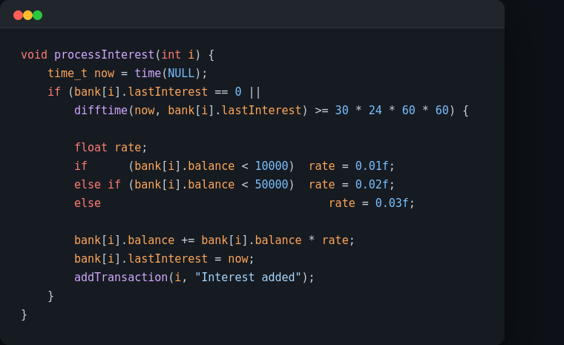
TIERED AUTOMATIC MONTHLY INTEREST
INTEREST IS CALCULATED ON LOGIN USING TIME.H — TIERED BY BALANCE, JUST LIKE A REAL SAVINGS ACCOUNT.
difftime() checks if 30 days have elapsed since lastInterest was saved to the account.
Three tiers: 1% under ₹10K, 2% from ₹10K–₹50K, 3% above ₹50K.
Interest is logged as a transaction and the timestamp is updated immediately. Uses POSIX time_t — no external libraries needed beyond standard time.h.

Slide 7
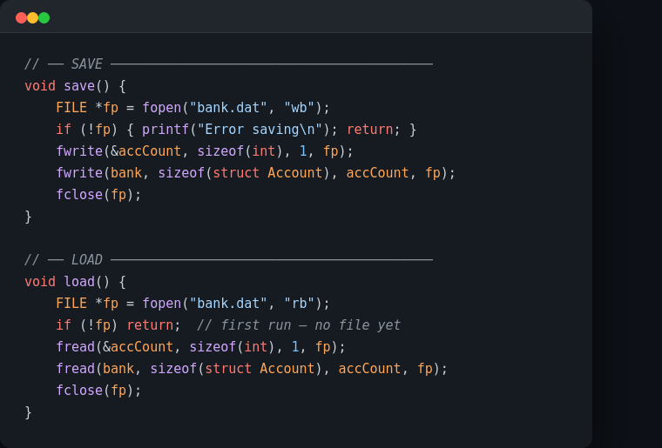
BINARY FILE PERSISTENCE
THE ENTIRE BANK STATE IS SERIALIZED TO DISK IN ~10 LINES USING C'S DIRECT MEMORY I/O.
fwrite() writes the struct array directly as raw bytes — no serialization overhead.
fread() reloads the exact same memory layout on startup, restoring all accounts.
Binary format is compact and fast; no CSV parsing or JSON libraries needed. This is how embedded systems and game save files work — raw binary I/O.

Slide 8
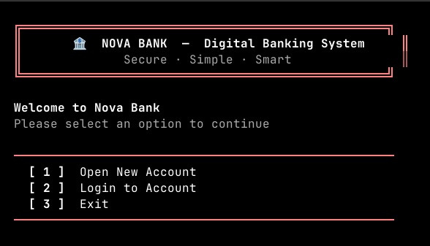
OUTPUT

Slide 9
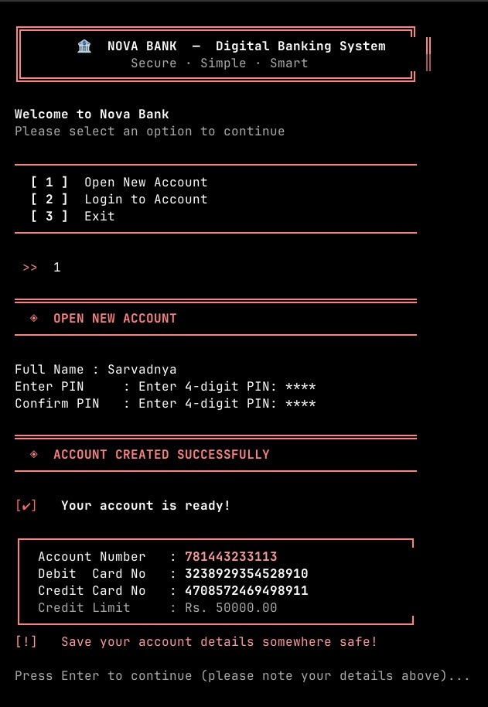
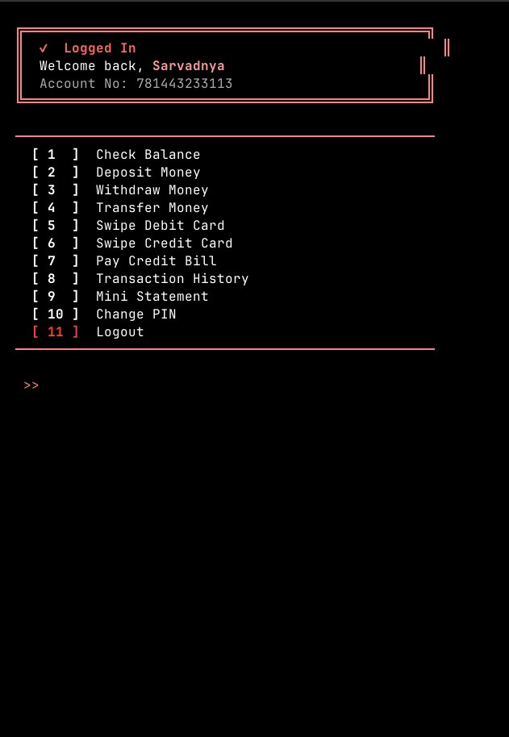
OUTPUT

Slide 10

THANK YOU
Scan this to access our GitHub

